Slide 1


VIPIN KUMAR

Slide 2

Outline
Executive Summary
Introduction
Methodology
Results
Conclusion
Appendix

Slide 3
Executive Summary
Summary of methodologies
Data Collection
Data Wrangling
Exploratory Data Analysis
Visual Analytics
Predictive Analysis
Summary of all results
EDA Results
Geospatial Analytics
Interactive Dashboard
Predictive Analysis

Slide 4

Introduction
Project background and context
Falcon 9 rockets which cost around 62m dollars launches by Space X. This is cheaper than other providers and then we can re-use the first stage of the rocket.
Problems you want to find answers
This project will predict if the space X Falcon 9 first stage will land successfully.

Slide 5

Section 1

Slide 6
Methodology
Executive Summary
Data collection methodology:
Making GET requests to the Space X REST API
Web Scrapings
Perform data wrangling
Using the .fillna method to remove NaN values
Using .value_counts() method to determine the number of launches , number of occurrence of each orbit etc.
Creating a landing outcome label that shows 0 when the booster did not land successfully and 1 when the booster did land successfully.
Perform predictive analysis using classification models
How to build, tune, evaluate classification models

Slide 7
Conti…
Perform exploratory data analysis (EDA) using visualization and SQL
Using SQL queries to manipulate and evaluate the space X dataset
Using Pandas and Matplotlib to visualize relationship between variables , and determine pattern
Perform interactive visual analytics using Folium and Plotly Dash
Geospatial analytics using folium
Creating an interactive dashboard using plotly Dash
Perform predictive analysis using classification models
Using Scikit-Learn to preprocess the data, Split the data, Train different classification models etc.
Plotting confusion matrices for each classification model.
Calculating the accuracy of each classification model.

Slide 8
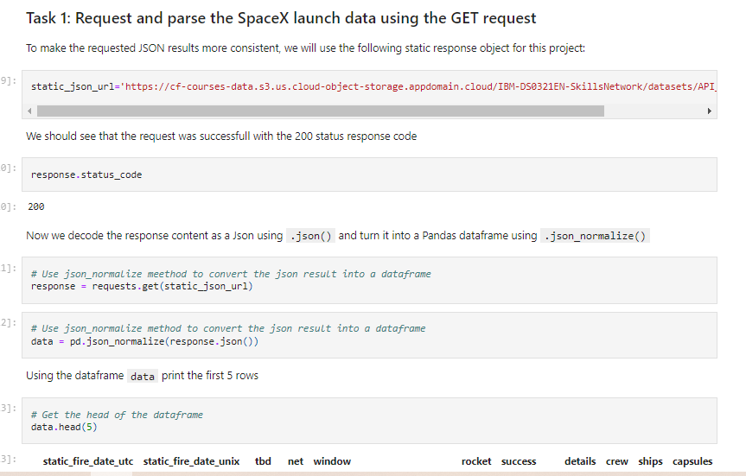
Data Collection
Describe how data sets were collected.
And You need to present your data collection process use key phrases and flowcharts

Slide 9
Data Collection - Scraping
Web scraping to collect falcon 9 historical launch ecords from a Wikipedia page titled list of Falcon 9 Heavy launches.
static_url = "https://en.wikipedia.org/w/index.php?title=List_of_Falcon_9_and_Falcon_Heavy_launches&oldid=1027686922"
# use requests.get() method with the provided static_url
response = requests.get(static_url)
# assign the response to a object
data = response.text
# Use BeautifulSoup() to create a BeautifulSoup object from a response text content
soup = BeautifulSoup(data, 'html5lib')
# Use soup.title attribute
print(soup.title)
# Use the find_all function in the BeautifulSoup object, with element type `table`and Assign the result to a list called `html_tables`
html_tables = soup.find_all('table')
# Let's print the third table and check its content
first_launch_table = html_tables[2]

Slide 10
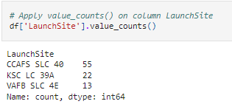
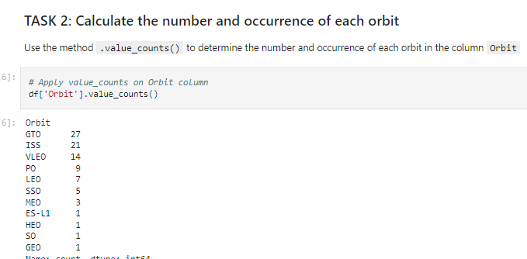
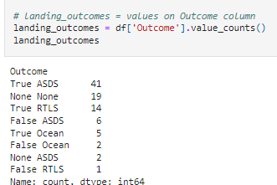
Data Wrangling
In this lab, we will perform some Exploratory Data Analysis (EDA) to find some patterns in the data and determine what would be the label for training supervised models.
In the data set, there are several different cases where the booster did not land successfully. Sometimes a landing was attempted but failed due to an accident; for example, True Ocean means the mission outcome was successfully landed to a specific region of the ocean while False Ocean means the mission outcome was unsuccessfully landed to a specific region of the ocean. True RTLS means the mission outcome was successfully landed to a ground pad False RTLS means the mission outcome was unsuccessfully landed to a ground pad. True ASDS means the mission outcome was successfully landed on a drone ship False ASDS means the mission outcome was unsuccessfully landed on a drone ship.

Slide 11


EDA with Data Visualization
Scatter Chart-
Scatter are useful to observe relationship, or correlations, between two numeric variables.
Flight number and Launch site
Payload and Launch Site
Orbit Type and Flight Number
Payload and orbit Type
Bar Chart-
Bar charts are used to compare a numeric value to categorical variable.
Success rate and Orbit Type

Slide 12

Conti…
Line Chart-
Line Charts contain numerical values on both axes and are generally used to show the change of a variable over time.
Success Rate and year

Slide 13
EDA with SQL
The SQL queries performed on the data set-
Display the name of unique launch sites in the space mission.
Display 5 records where launch sites begin with the string “CCA”
Display the total payload mass carried by boosters launched by NASA
Display the average payload mass carried by booster version F9v1.1
List the data when the first successful landing outcome on a ground pad was achieved.
List the names of the boosters which had success on a drone ship and payload mass
List the failed landing outcomes on drone ship,their booster version and launch site name

Slide 14
Build an Interactive Map with Folium
The following steps were taken to visualize the launch data on an interactive map
Mark all the site on a map.
Mark the success/failed launches for each site on a map.
Calculate the distances between a launch site to its proximities.
The following plots were added to a plotly Dash dashboard to have an interactive visualization of the data
Pie chart showing the total successful launches per site
Scatter graph to show the correlation between outcome and payload mass.

Slide 15
Predictive Analysis (Classification)
Model Development-
To prepare the dataset for model development:
Load data set
Standrardise and pre-process
Split data
Decide algorithms
Model Evaluation-
For each chosen algorithms-
Using the output GridSearchCV object:
Plot examine the confusion matrix
Finding the Best classification model-
Review the accuracy scores for all chosen algorithms.
The model with the highest accuracy score is determined as the best performing model.

Slide 16

Section 2

Slide 17
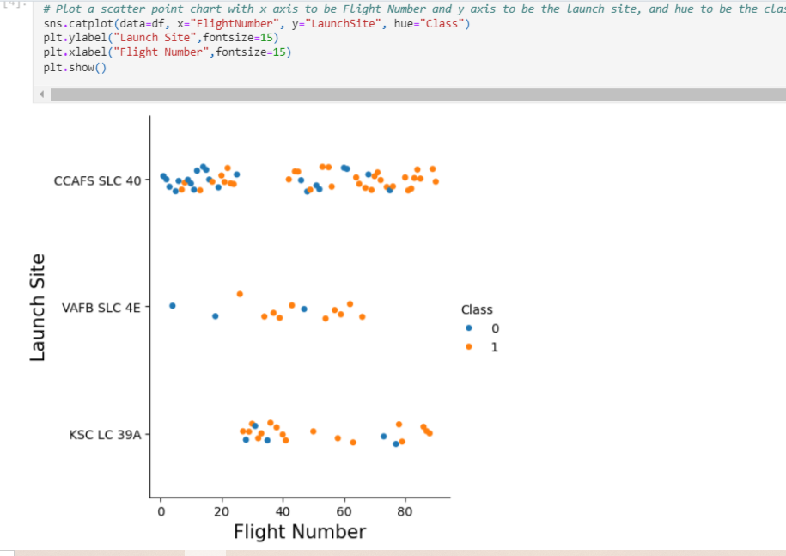
Flight Number vs. Launch Site
Show a scatter plot of Flight Number vs. Launch Site

Slide 18
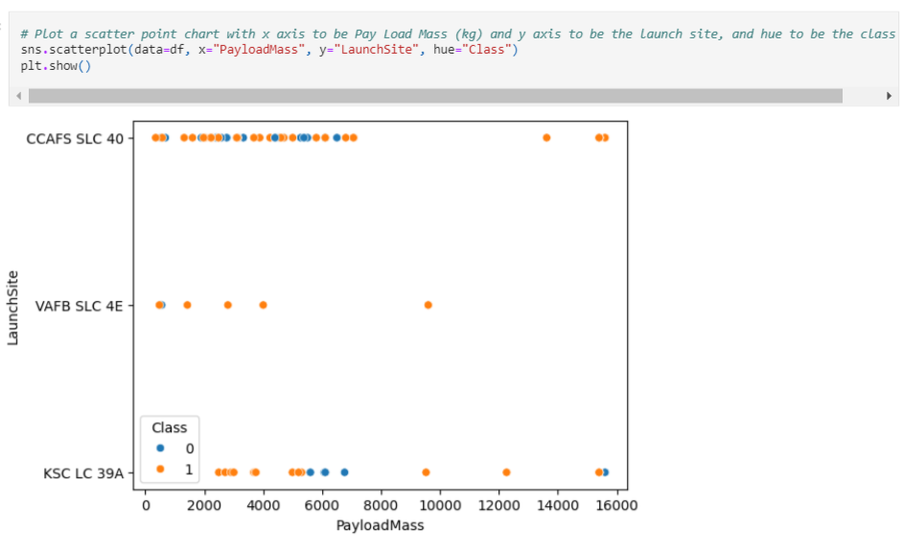
Payload vs. Launch Site
Show a scatter plot of Payload vs. Launch Site

Slide 19
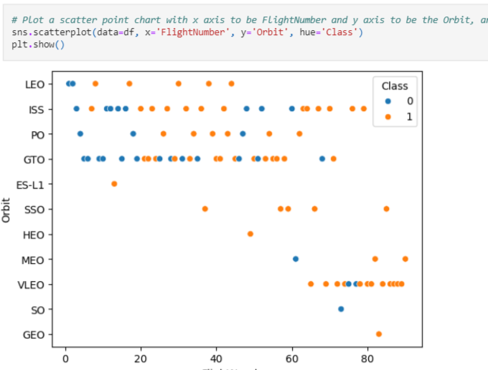
Flight Number vs. Orbit Type
Show a scatter point of Flight number vs. Orbit type

Slide 20
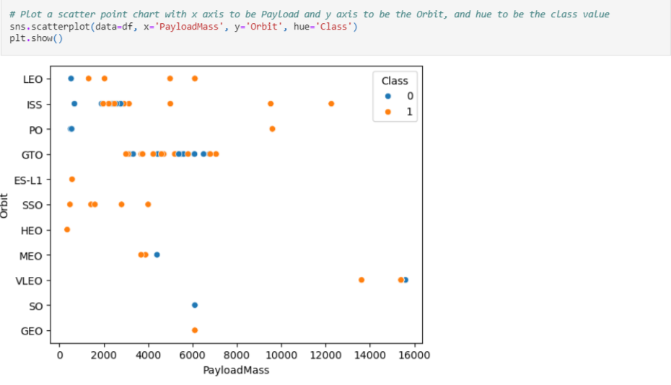
Payload vs. Orbit Type
Show a scatter point of payload vs. orbit type

Slide 21
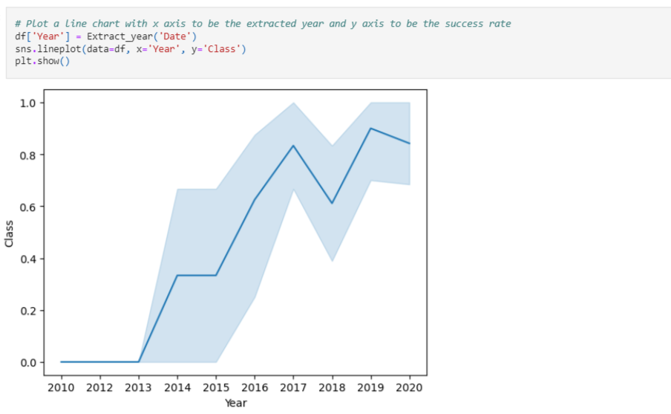
Launch Success Yearly Trend
Show a line chart of yearly average success rate

Slide 22
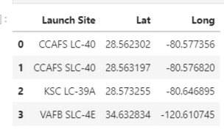
All Launch Site Names
Find the names of the unique launch site

Slide 23
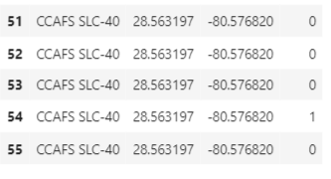
Launch Site Names Begin with 'CCA'
5 records where launch sites begin with `CCA’

Slide 24
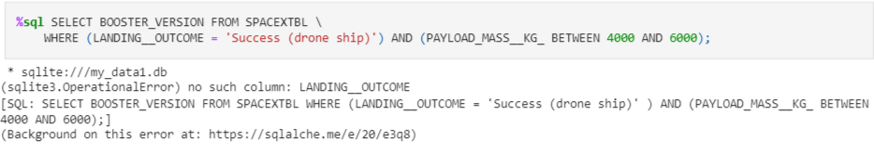
Successful Drone Ship Landing with Payload between 4000 and 6000
List the names of boosters which have successfully landed on drone ship and had payload mass greater than 4000 but less than 6000

Slide 25
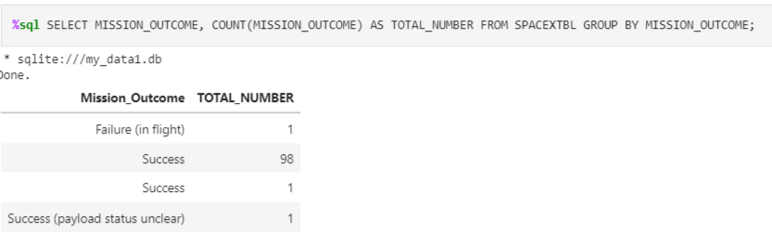
Total Number of Successful and Failure Mission Outcomes
Calculate the total number of successful and failure mission outcome

Slide 26
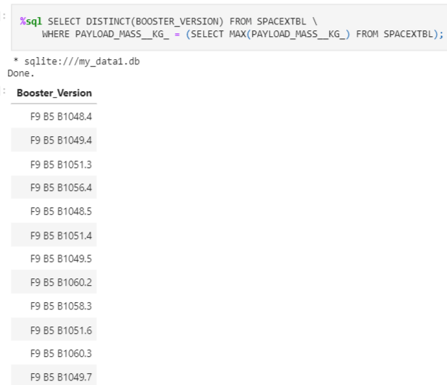
Boosters Carried Maximum Payload
List the names of the booster which have carried the maximum payload mass

Slide 27
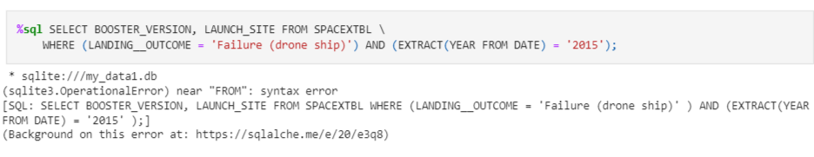
2015 Launch Records
List the failed landing_outcomes in drone ship, their booster versions, and launch site names for in year 2015

Slide 28
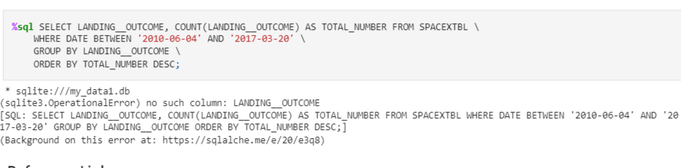
Rank Landing Outcomes Between 2010-06-04 and 2017-03-20
Rank the count of landing outcomes (such as Failure (drone ship) or Success (ground pad)) between the date 2010-06-04 and 2017-03-20, in descending order

Slide 29

Section 3

Slide 30
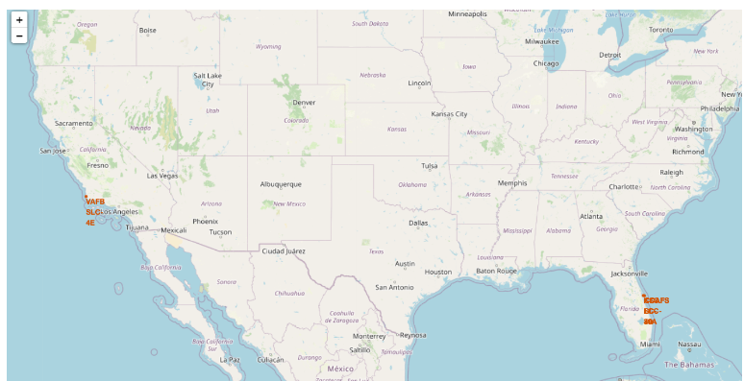
<Folium Map Screenshot 1>
Replace <Folium map screenshot 1> title with an appropriate title

Slide 31
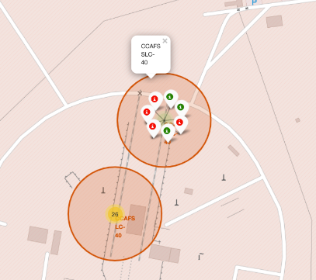
<Folium Map Screenshot 2>
Replace <Folium map screenshot 2> title with an appropriate title

Slide 32
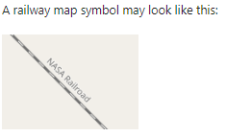
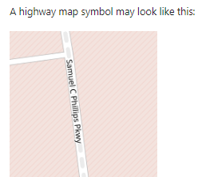

<Folium Map Screenshot 3>
Replace <Folium map screenshot 3> title with an appropriate title

Slide 33

Section 4

Slide 34
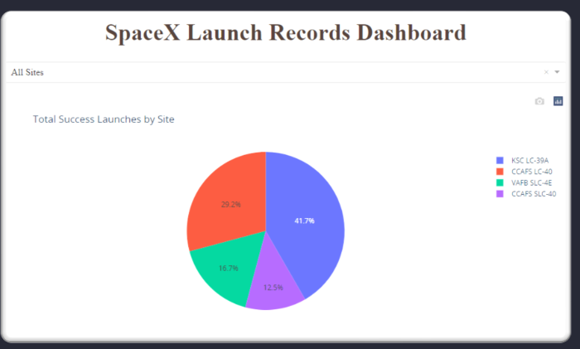
<Dashboard Screenshot 1>
Replace <Dashboard screenshot 1> title with an appropriate title

Slide 35
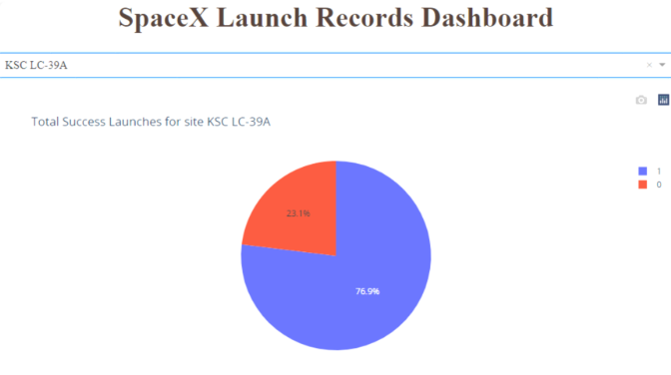
<Dashboard Screenshot 2>
Replace <Dashboard screenshot 2> title with an appropriate title

Slide 36

Section 5

Slide 37
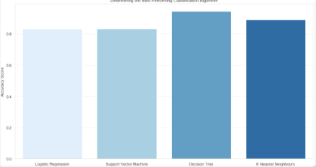
Classification Accuracy
Visualize the built model accuracy for all built classification models, in a bar chart
Decision Tree model have highest accuracy.

Slide 38
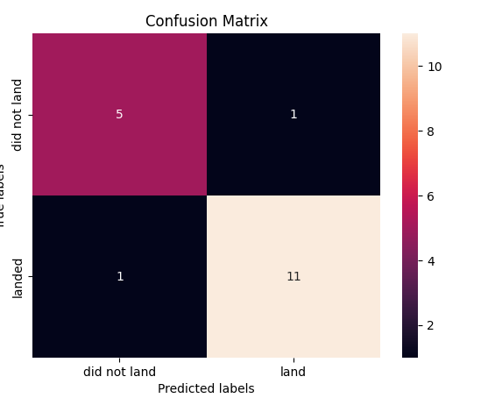
Confusion Matrix
Show the confusion matrix of the best performing model
Out of 18 prediction only one prediction is incorrect.

Slide 39
Conclusions
Decision tree is the best performing model which accuracy 94.44%.
Lower payload is more successful as compare to passive payload
The launch site KSC LC-39 A had the most successful launches, with 41.7% of the total successful launches, and also the highest rate of successful launches, with a 76.9% success rate.
As flight frequency rises, so does the likelihood of success at the launch site, particularly after initial unsuccessful attempts. Essentially, as experience grows, success rates improve.
• Throughout 2010 to 2013, every landing ended in failure, registering a success rate of 0.
• Post-2013, there's a consistent uptrend in success rates, notwithstanding minor declines in 2018 and 2020.
• From 2016 onwards, the probability of success consistently surpasses 50%…

Slide 40


